Slide 1


Fire & Robbery Avoidance System
Measurements and Electronic Sensors (ELC2707)
Under Supervision of: Dr. Azza M. Anis
2023-2024

Slide 2
Contents
01
02
03
04
05
06
Introduction
Component
Simulation
Source code
Real time
Sources

Slide 3
01 Introduction
Title: Fire Alarm System with Flame Sensor and Ultrasonic Proximity Detection
Brief overview of the project's purpose and functionality: Detecting fires using
a flame sensor and providing proximity warnings using an ultrasonic sensor.
The system also includes an LCD display to show relevant information.

Slide 4
Block diagram
Ultrasonic
sensor
LCD Display
16x2
Arduino nano
MCU
Flame
sensor
H-Bridge
DC
Fan
Buzzer

Slide 5
02
Component
Arduino Nano
Flame Sensor
Ultrasonic Sensor
Buzzer
LCD Display
DC Fan
H-Bridge
Resistors
Jumpers

Slide 6
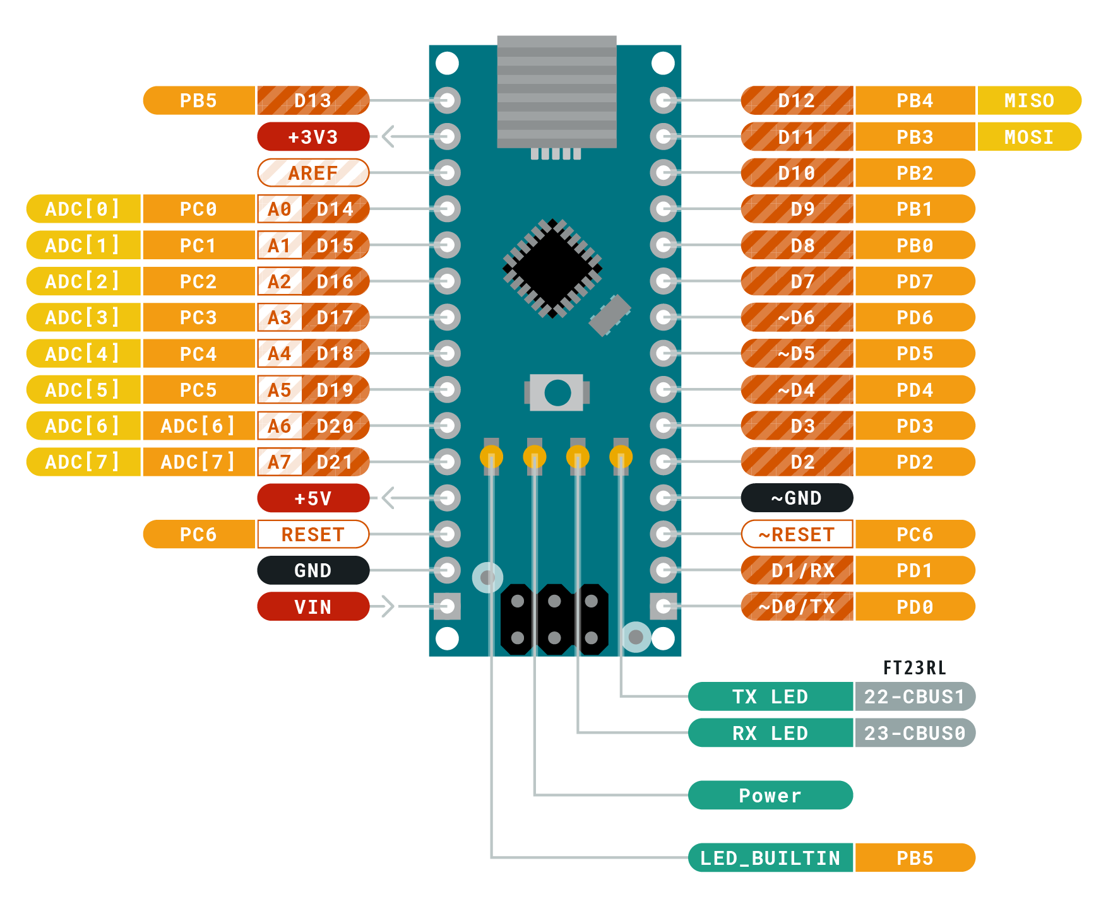
1. Arduino Nano
The Arduino Nano is a microcontroller-based device with 14 digital pins that can be used for various purposes. It can be used for almost every task, from minor to massive industrial-scale projects. It can also be used for prototyping and developing new applications.

Slide 7
1. Arduino Nano
Here's a simple representation of the pinout for the Arduino Nano:
Digital Pins (D0-D13):D0 to D13 are digital input/output pins. They can be used for reading digital signals or outputting digital signals.
Analog Pins (A0-A7):A0 to A7 are analog input pins. They can read analog voltage levels from sensors or other devices.
Power Pins:5V: This pin provides a regulated 5V supply to the board.
3.3V: This pin provides a regulated 3.3V supply to the board.
VIN: This pin can be used to power the board from an external power source (7-12V).

Slide 8
1. Arduino Nano
GND: There are multiple ground (GND) pins available for connecting ground.
Specialized Pins:RESET: This pin is used to reset the microcontroller.
RX and TX: These pins are used for serial communication.
PWM Pins: Some digital pins support PWM (Pulse Width Modulation), allowing for analog output through software.
I2C and SPI Pins:SCL, SDA: These pins are used for I2C communication.
MOSI, MISO, SCK: These pins are used for SPI communication.
Other Pins:AREF: Analog Reference voltage for the analog inputs.

Slide 9
Used pins:
Flame sensor:
A4→D0 pin
( digital input)
Ultrasonic sensor:
D8→trigger pin,D7→echo pin
(analog input)
LCD Display:
D2,D4,D5,D6 →(D4-D7)
D11→EN,D12→RS
( digital output)
H-Bridge:
A0→IN1,A1→IN2,A2→ENA
(analog output)
Buzzer:
A3→+ve
(digital output)

Slide 10
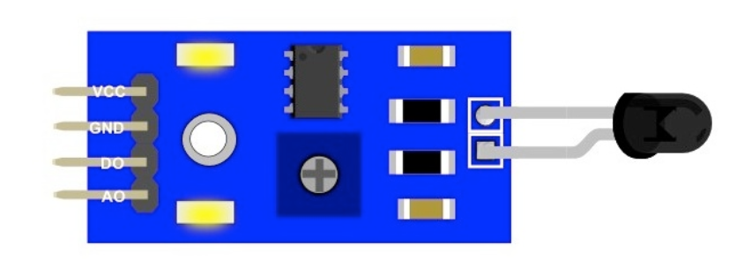
2. Flame Sensor
This module is sensitive to the flame and radiation. It also can detectordinary light source in the range of of a wavelength 760nm-1100 nm. Thedetection distance is up to 100 cm.The Flame sensor can output digital or analog signal. It can be used as aflame alarm or in fire fighting robots.
Interface Description (4-wire)
1) VCC -- 3.3V-5V voltage
2) GND – GND
3) DO -- board digital output interface (0 and 1)
4) AO -- board analog output interface

Slide 11
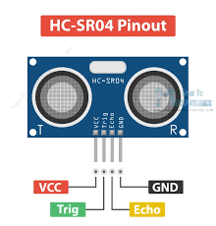
3. Ultrasonic Sensor
The ultrasonic sensor module is a circuit with four pins. To detect the transmitted signal, hold the Trig pin high for about 10 micro seconds. On the other hand, the echo pin functions as the output pin. When the reflected signal arrives, it causes an output pulse, which the system converts into an electrical signal

Slide 12
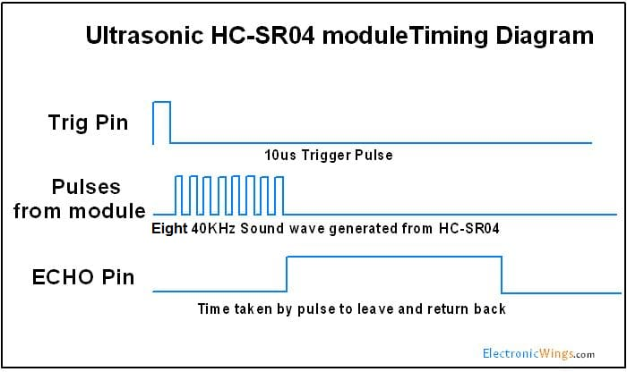
3. Ultrasonic Sensor
The configuration pin of HC-SR04 is VCC (1), TRIG (2), ECHO (3), and GND (4). The supply voltage of VCC is 5V and you attach TRIG and ECHO pin to any Digital I/O in your Arduino Board to power it.

Slide 13
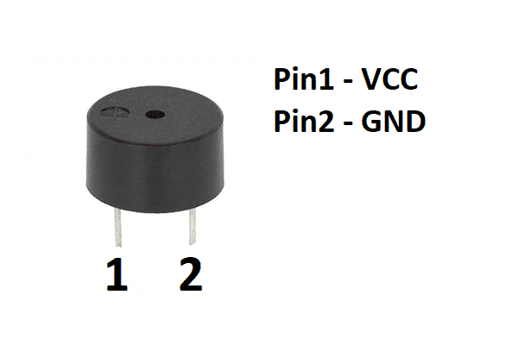
4. Buzzer
A buzzer is not a sensor. It is an output device used to make a sound or tone. Sensors are input devices that detect changes in the environment, like temperature or light, and convert them into electrical signals. Instead, receives electrical signals to generate sound

Slide 14
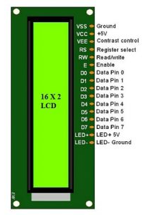
5. LCD Display
The term LCD stands for liquid crystal display. It is one kind of electronic display module used in an extensive range of applications like various circuits & devices like mobile phones, calculators, computers, TV sets, etc. These displays are mainly preferred for multi-segment light-emitting diodes and seven segments. The main benefits of using this module are inexpensive; simply programmable, animations, and there are no limitations for displaying custom characters, special and even animations.

Slide 15
5. LCD Display
To wire your LCD screen to your board, connect the following pins:
LCD RS pin to digital pin 12.
LCD Enable pin to digital pin 11.
LCD D4 pin to digital pin 5.
LCD D5 pin to digital pin 4.
LCD D6 pin to digital pin 3.
LCD D7 pin to digital pin 2.
LCD R/W pin to GND.
LCD VSS pin to GND.

Slide 16
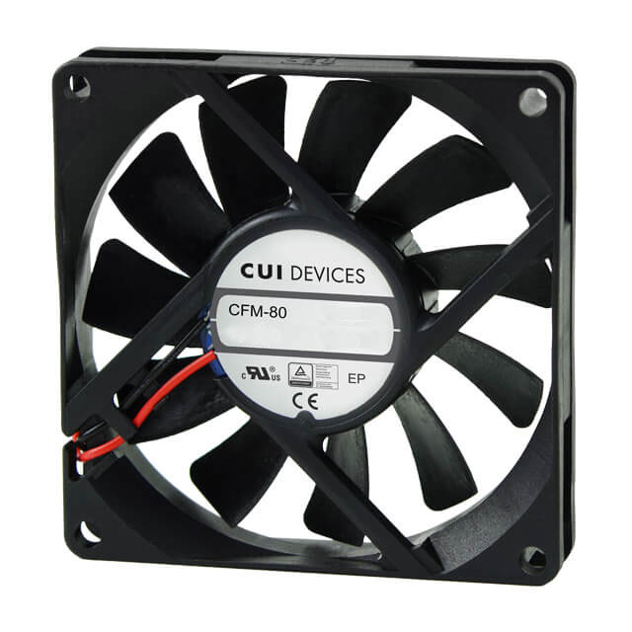
6. DC Fan
DC fans are fans that are powered by the direct current. Like AC Axial fans, there are DC axial fans and DC cross flow fans too. DC axial fans are widely used in the air-vent exhaust, electronic device cooling, computer ventilation, etc.
In simple terms, a DC fan is a cooling fan that converts electrical energy into electromagnetic energy through DC voltage and electromagnetic induction, and then electromagnetic energy into mechanical energy, and finally into kinetic energy, so that the fan blades rotate

Slide 17
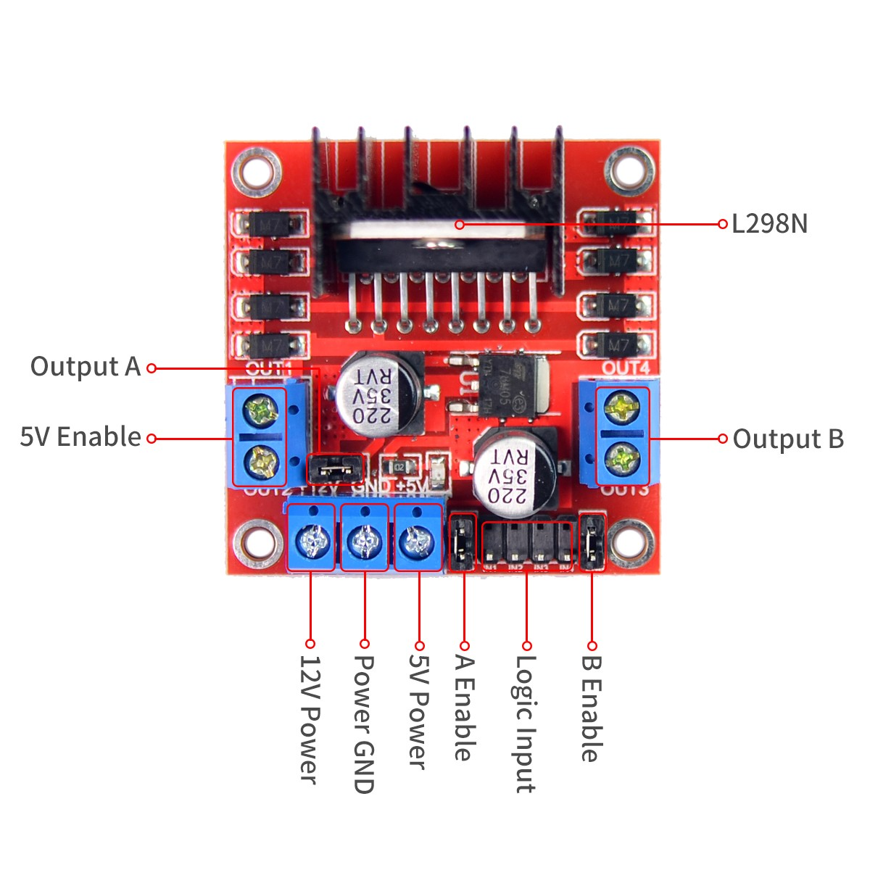
7. H Bridge
L298N Dual H Bridge Motor Driver is a motor controller breakout board which is typically used for controlling speed and direction of motors. It can also be used to control the brightness of certain lighting projects such as high powered LED arrays.
The L298N Motor Driver module consists of an L298 Motor Driver IC, 78M05 Voltage Regulator, resistors, capacitor, Power LED, 5V jumper in an integrated circuit. 78M05 Voltage regulator will be enabled only when the jumper is placed

Slide 18
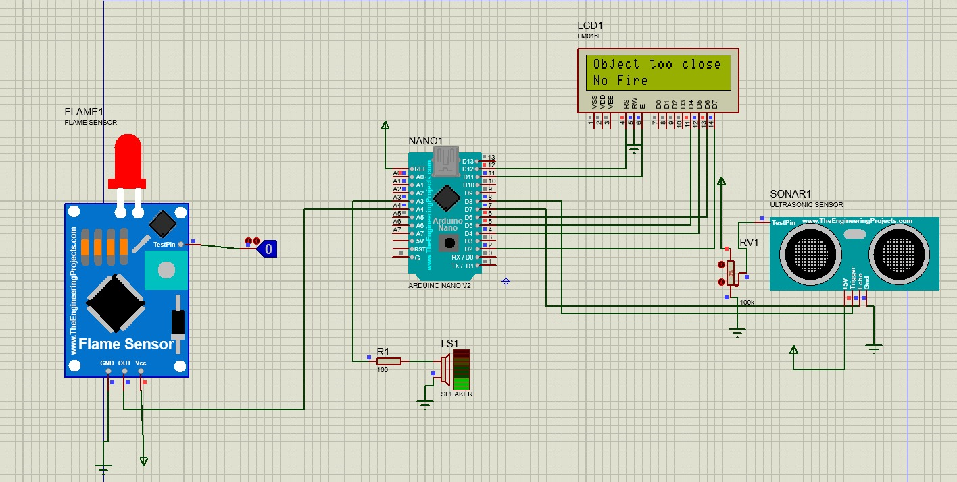
03 Simulation

Slide 19
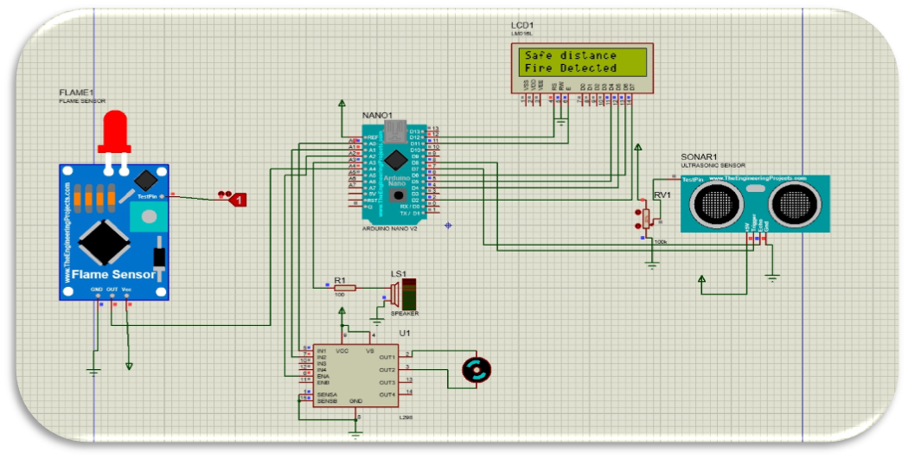

Slide 20
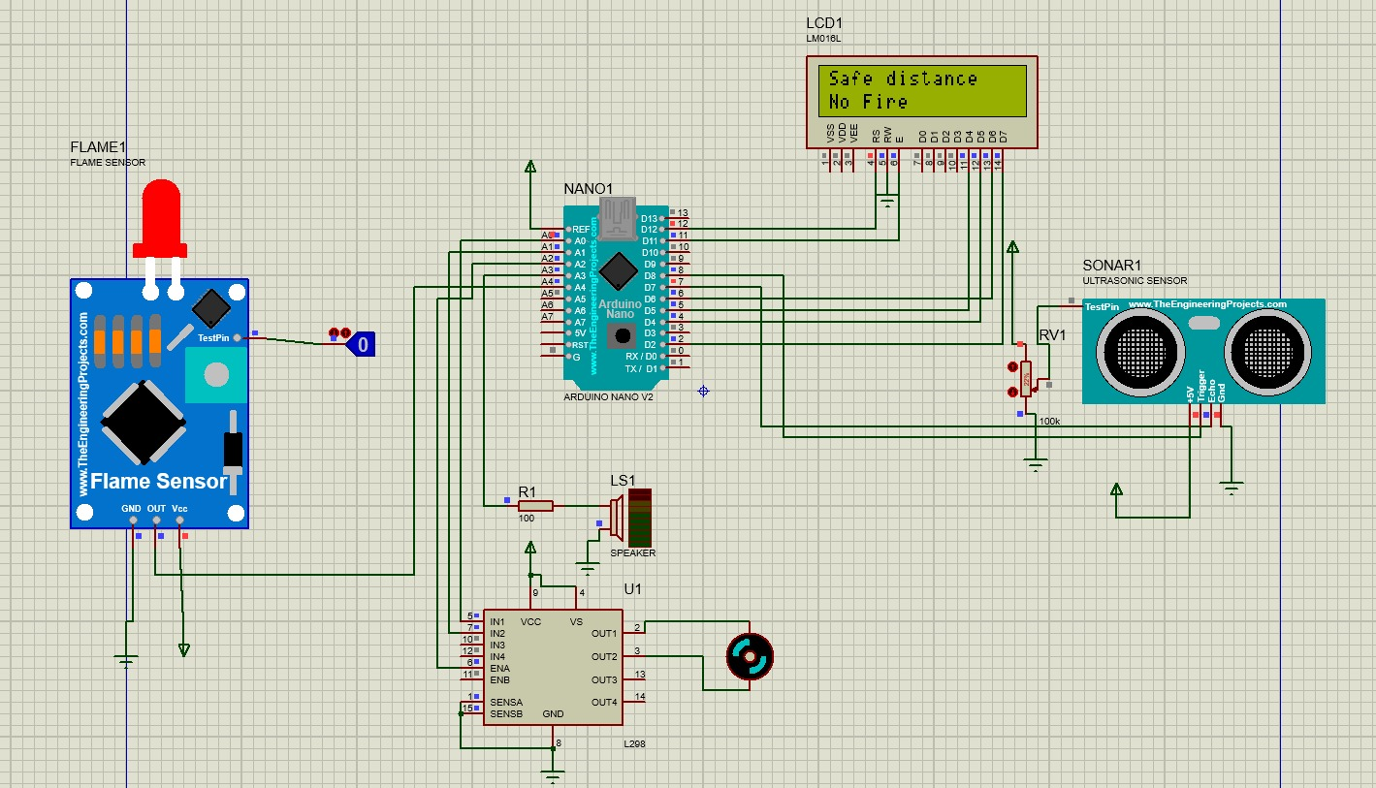

Slide 21
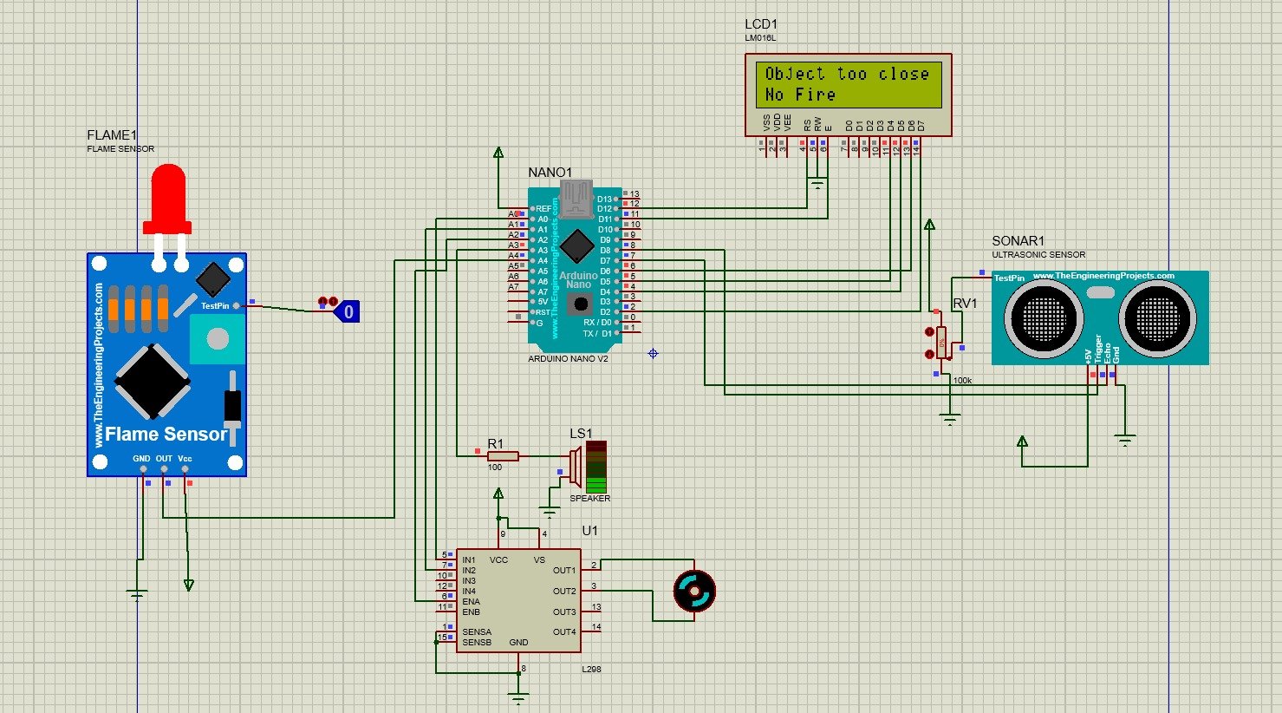

Slide 22
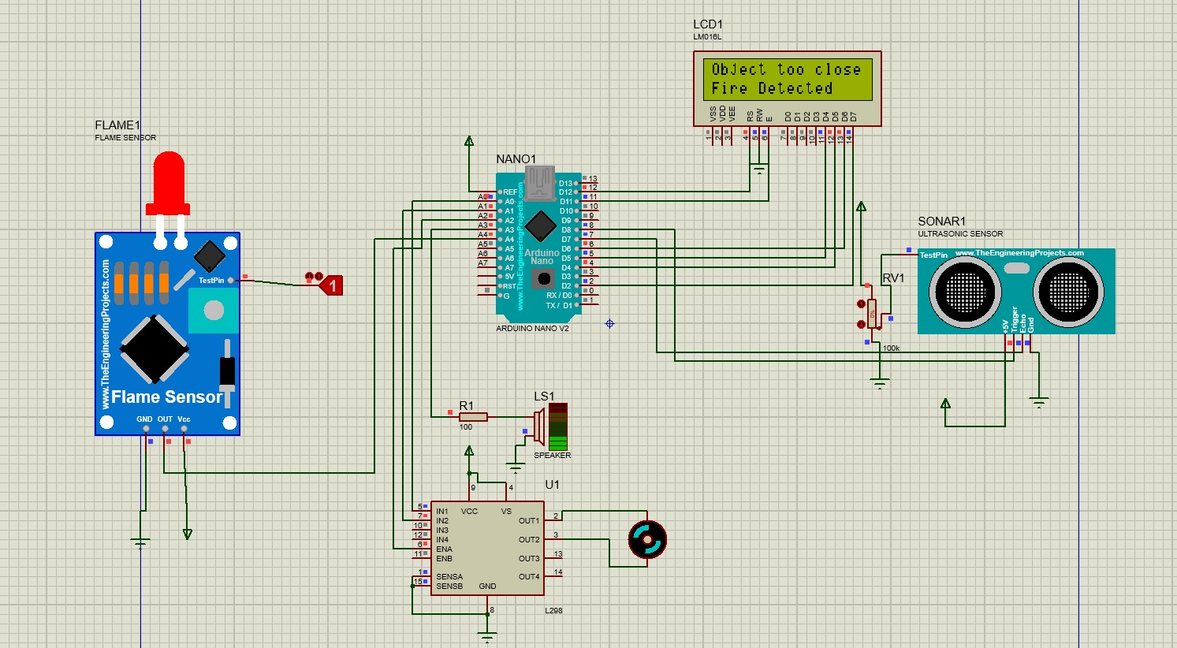

Slide 23
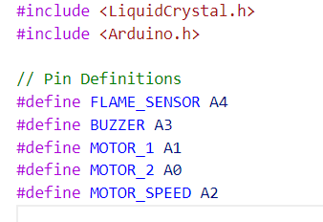
04 Source code

Slide 24

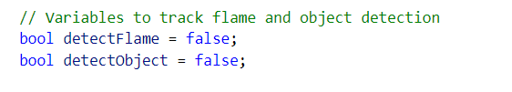
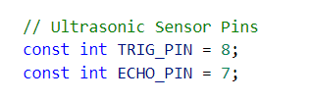
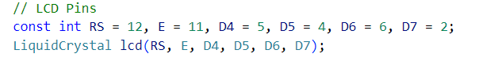

Slide 25
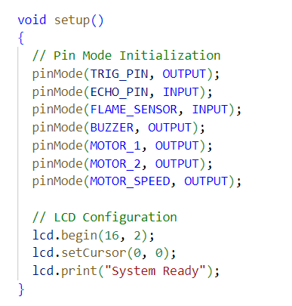

Slide 26
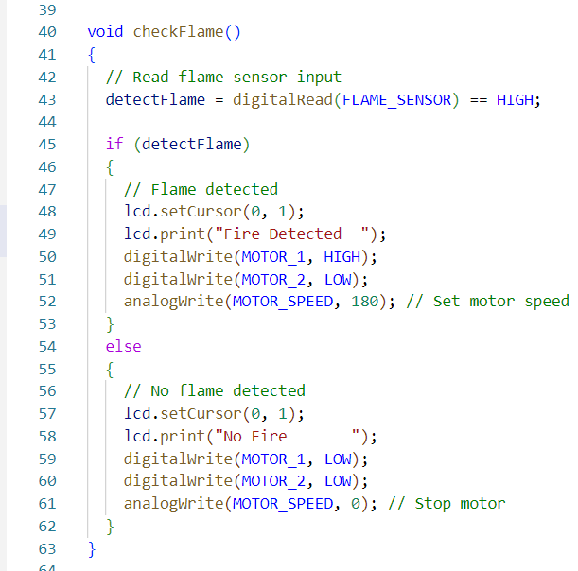

Slide 27
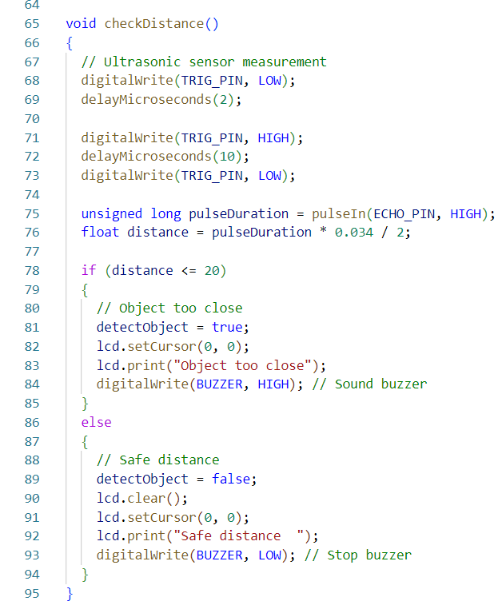

Slide 28
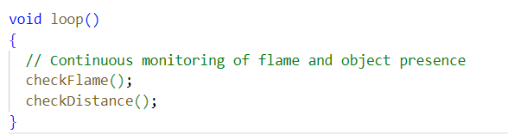
The code utilizes Arduino with various components like a flame sensor, ultrasonic sensor, buzzer, and LCD display. It continuously monitors for both flame detection and object proximity. When a flame is detected, it activates a motor and displays a corresponding message on the LCD. Additionally, it alerts when an object is too close using the buzzer and updates the LCD accordingly.

Slide 29
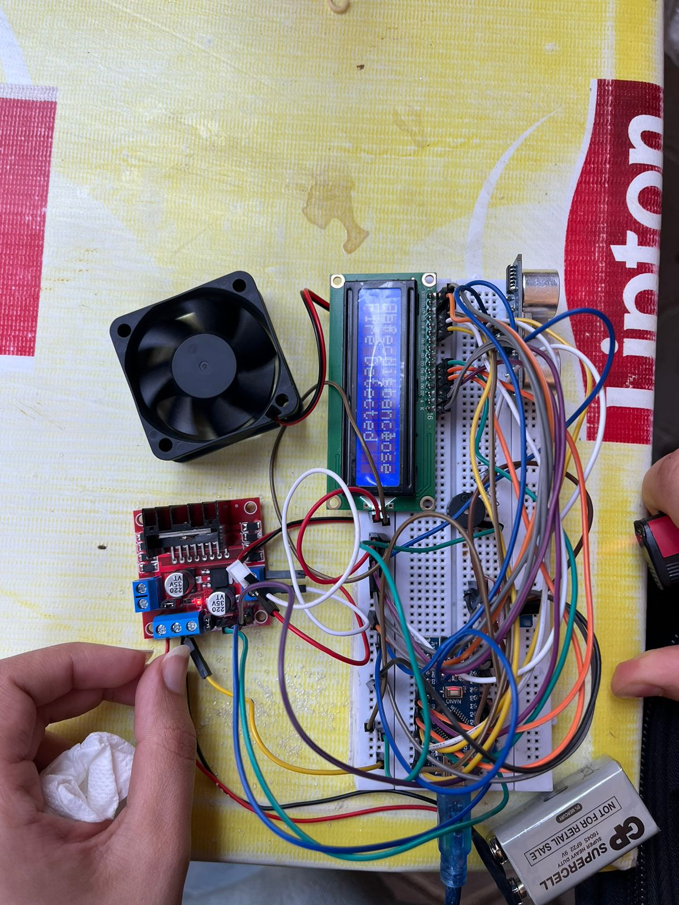
05 Realtime

Slide 30
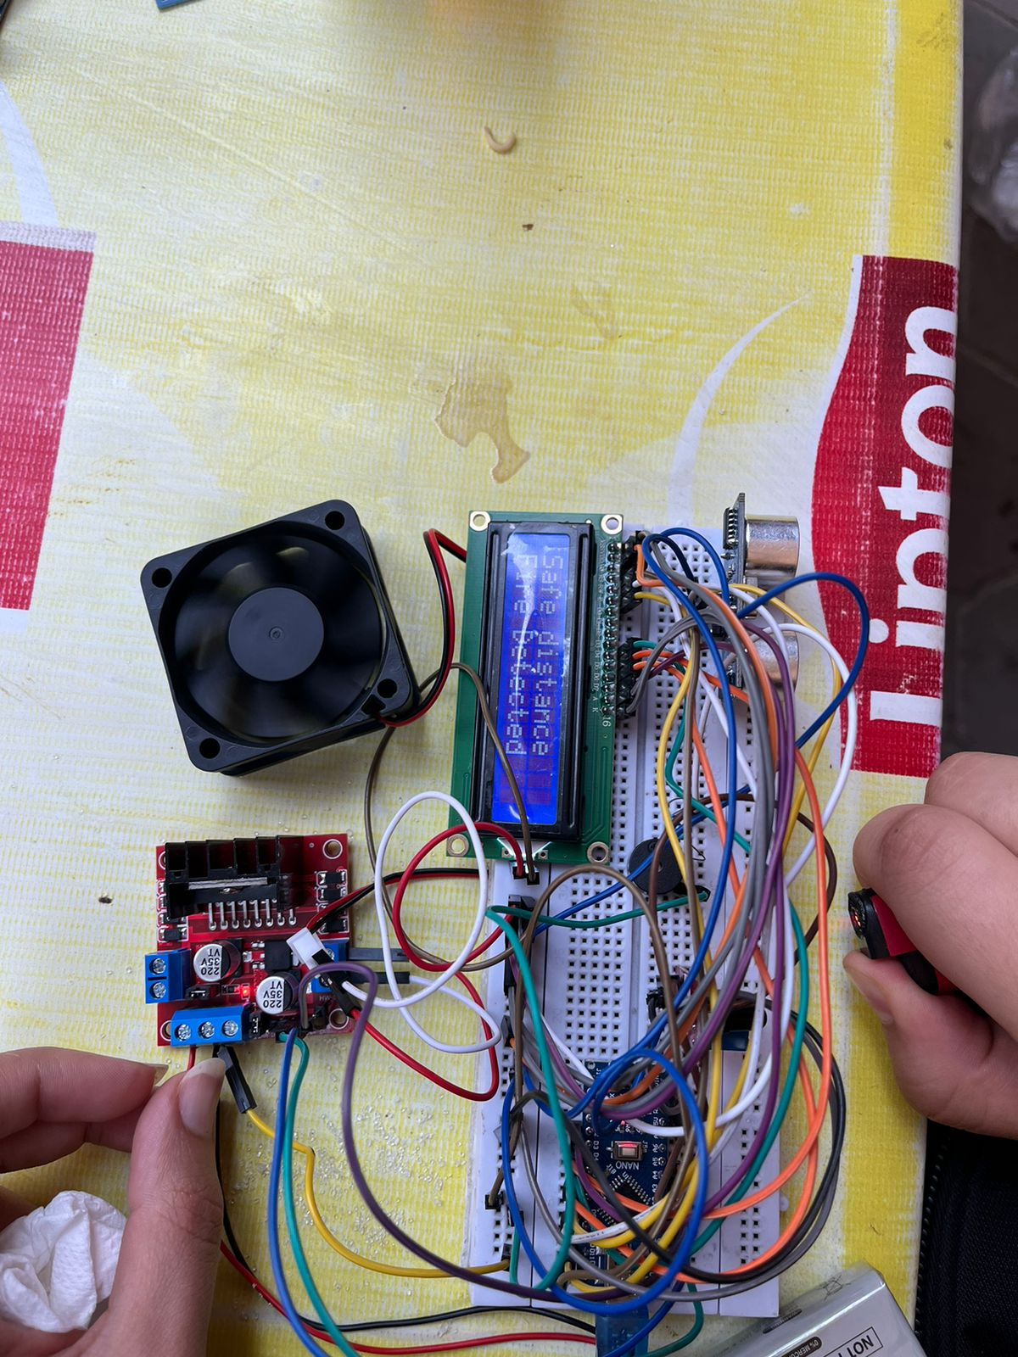

Slide 31
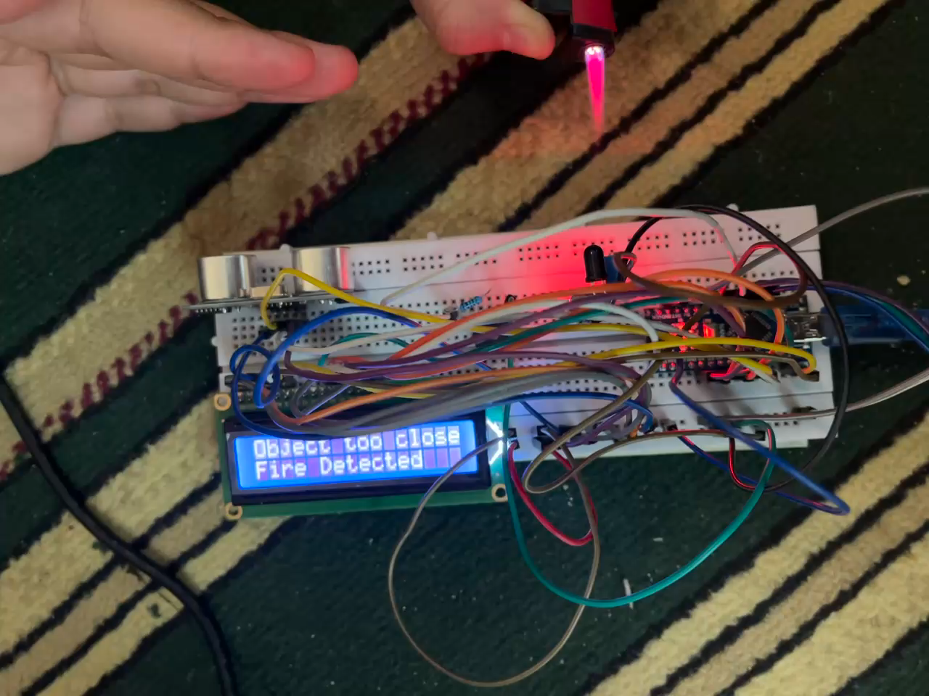

Slide 32
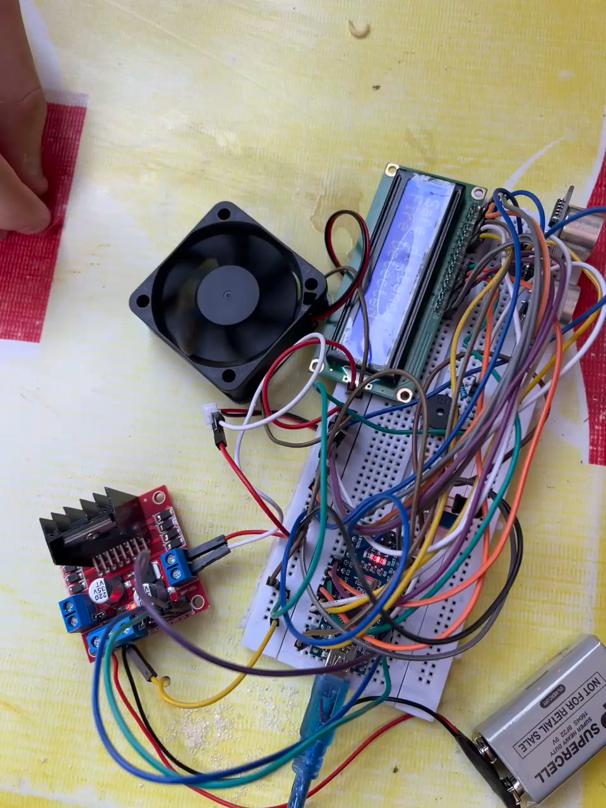

Slide 33

Problems Encountered:
Gross error:
Due to some malfunctions in wiring
Systematic error:
Due to some short circuit issues in the test board
Logical error:
Some errors in the logic of the code

Slide 34
06 Resources
http://simplyarduino.com/%D9%83%D8%AA%D8%A7%D8%A8-simply-avr/
https://docs.arduino.cc/resources/datasheets/A000005-datasheet.pdf
https://components101.com/sites/default/files/component_datasheet/16x2%20LCD%20Datasheet.pdf
https://www.datasheethub.com/wp-content/uploads/2022/10/flame-sensor-module-arduino.pdf
https://components101.com/sites/default/files/component_datasheet/HCSR04%20Datasheet.pdf
https://heshameladawydotcom.files.wordpress.com/2017/12/d8a7d984d985d8aad8add983d985d8a7d8aa.pdf
https://docs.rs-online.com/1cb8/0900766b813279f6.pdf
https://components101.com/modules/l293n-motor-driver-module

Slide 35
Our great team
Mariem Ossama Hussin
Eman Ahmed Ramdan
Mariam Alaa-ElDin Mohamed
Mariem Mohammed Ahmed
Mariem Maher Mohammed

Slide 36

Thanks!

